Slide 1
Advanced Graphics – Physically Based Rendering
Jainesh Pathak
June 2023
School of Computing Science
Newcastle University
J.P.Pathak2@newcastle.ac.uk

Slide 2
Background
Lighting plays an important role to bring realism in computer graphics.
2.5D games like Doom introduced “Sector-based” lighting and “Light Diminishing”:
Sector-Based Lighting:
Game level is divided into sectors. Every sector had a light level with range 0-255. 0 being complete dark and 255 being very bright.
Light Attenuation were done where light levels of neighbour sectors gradually decreases to show light is traveling over distance.
Light Diminishing:
Sector area from player’s point of view is bright enough for player to see and slowly decreases as the distance between area and player increases. Also used in simulating fog.
As GPUs progressed, lighting and overall video game graphics also progressed.
3D Games like Unreal, Doom 3 showcased more dynamic lighting with different light sources: Point, Directional, Spot Lights.
Blinn-Phong light model became widely popular and used in computer graphics.
Uses sum of three components: Ambient, Diffuse and Specular.
Blinn-Phong light model disadvantages:
Violates conservation of energy law. Energy is lost as specular intensity is increased.
Doesn’t take the metallic and roughness surface properties on a microfacet level in account.

Slide 3
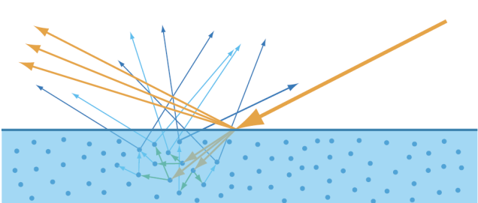
Introduction
Light Terminologies: Diffuse (Refraction) and Specular (Reflection)
Physically-based Rendering (PBR):
Lighting equations in real-life are too complex and computationally expensive.
PBR is collection of techniques to bring light interactions in the real world physics approximation.
To do physical approximations, it needs to follow three rules:
Based on microfacet surface model.
Energy conserving – outgoing light reflected should not exceed incoming light.
Uses a physically based BRDF.
Bidirectional reflective distribution function (BRDF):
Function that describes the reflectance properties of a the surface on a microfacet level.
Takes the incoming light L, view direction V, surface normal N and surface roughness A as inputs.
It approximates how much light ray gets reflected based on the surface properties.
The most famous is the Cook-Torrance BRDF:
Fr = Kd * fLambert + Ks * fCook-Torrance.
fLambert is the diffusion part.
fCook-Torrance is the specular part.

Slide 4
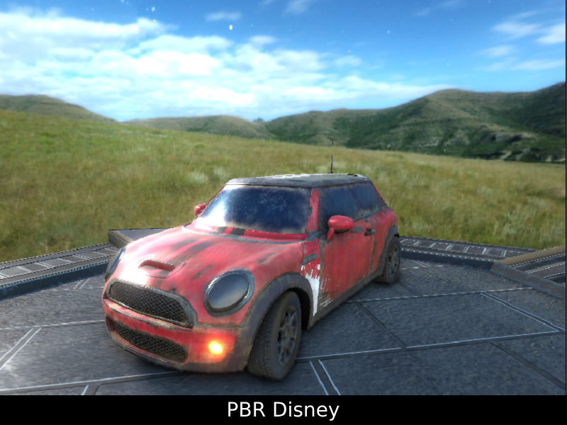
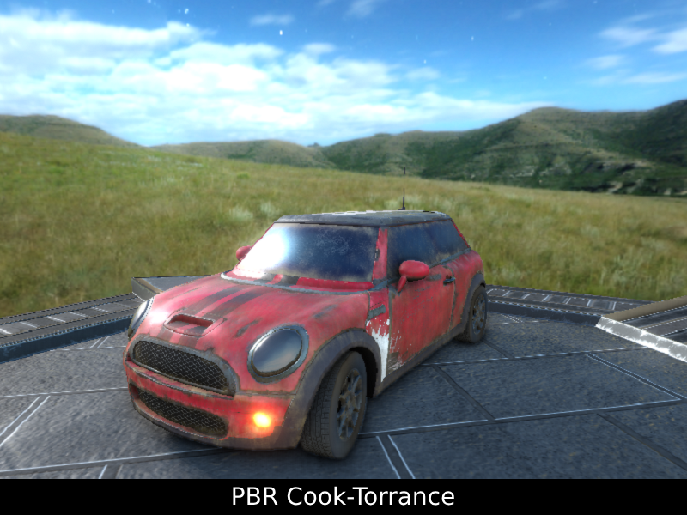
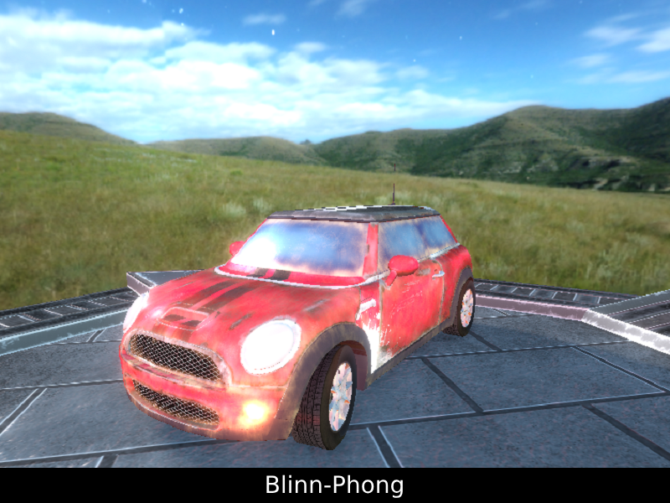
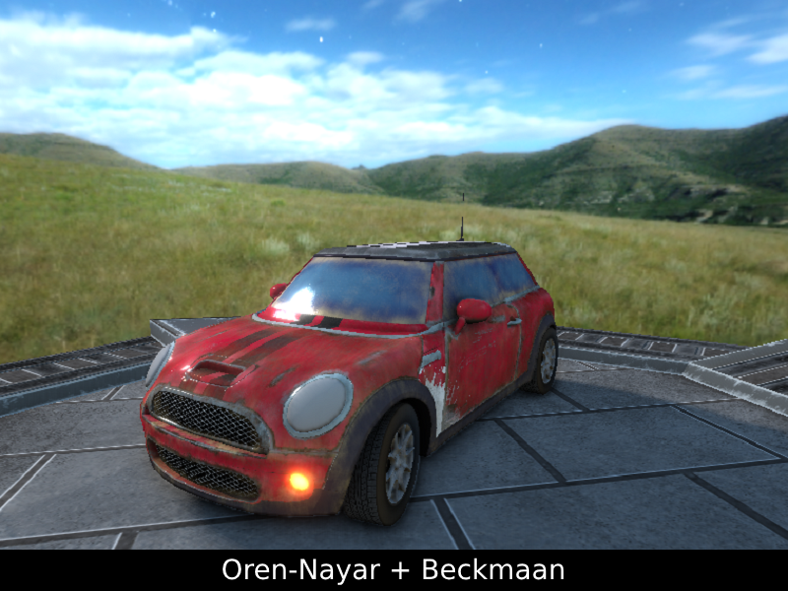
Implementations
Using OpenGL and NCLGL framework as a base.
Dear ImGui framework for debugging, tweaking parameters at runtime and profiling.
Different types of BRDFs are made for comparison:
PBR Cook-Torrance
PBR Disney
Blinn-Phong
Oren-Nayar + Beckmann/GGX/Gaussian
Post Processing Effects:
Bloom
Vignette
SSAO
Invert Colour
Gamma Correction and Tone Mapping:
Reinhard Tone Mapping

Slide 5
Implementations
Image-based Lighting (IBL):
Using HDR textures to convert to Cubemaps.
Exposure controllable from ImGui
Five different types of skybox used to show ambient lighting on surfaces
Diffuse Irradiance
Specular Prefiltering and Lookup table
For PBR, different textures are being used:
Albedo: Base colour
Normal: Surface details
Metallic: Metallic or Dielectric
Roughness: Controls the smoothness
Emission: Emitting light from surface
Ambient Occlusion: Enhances shading
Lights:
Billboard effect to show different types of light sources.
Material System:
Basic material system which applies to who mesh instead of sub-meshes.

Slide 6
Challenges
Lights Performance:
Sending light attributes to every frame is heavy on performance.
To counter this, Uniform Buffer Objects (UBO) are used.
OpenGL version 4.20 is used for easy setting the binding points of UBOs
Light attributes are stored in a struct and datatype of Vector4 are used for memory alignment and padding precisions.
Lights UBO Data are not sent every frame. Instead, they are sent when there is a change in any of the light attributes when using ImGui.
Uniform Buffer Objects:
Also used to store the view projection matrix.
Skybox light data like Gamma and Exposure intensity.
Texture Loading Time:
PBR Textures are quite heavy to load due to size of resolutions.
Loading the textures in main thread is not effective.
To solve this, Multi-threading is used.
The texture’s raw data are loaded using threads and once loaded the usual OpenGL texture objects are created loaded with raw data.
This reduced the loading time from 17 seconds to 7-8 seconds.

Slide 7
Analysis
Using UBO for lights and loading texture raw data using threads significantly improved the performance and loading time.
Frames Per Second (FPS) stayed at a stable 60 FPS with V-Sync on and approximately 300 FPS when V-Sync is off.

